Slide 1
Natural Language Processing
-S Soundarya

Slide 2
Contents
Python File Basics
PDF Handling and Regular Expressions in Python
NLP and NLP Packages: Spacy and NLTK
Classification Metrics
Text Classification
Feature Extraction using Count Vectorizer and TF-IDF
Sentiment Analysis using Spacy and VADER
Topic Modelling using LDA and NMF
RNN and LSTM
Chatbots

Slide 3
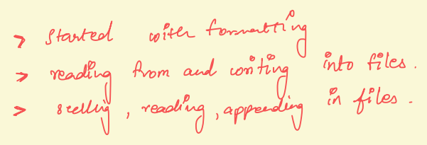
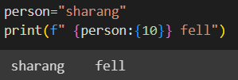
Python File Basics
Formatting
Read from a file
%%writefile test.txt : lets output code in a python module
f=open(‘filepath’) :default mode:read
f.read():reaches the eof after reading
f.seek(0)
lines=f.readlines()
.split() :returns an array of words in a line, default: spaces
f.close() :closing the file
Writing into a file
f=open(‘filepath’,’w’): opening a file in a 'w' or 'w+' mode overwrites the content of the file
f=open(‘filepath’,’a+’): creates a new file if doesn’t exist and appends to it
f.write('appending to the present’)
with open('test.txt','r') as myfile: can carry out any operation, file will automatically close once this block ends
file_basics

Slide 4
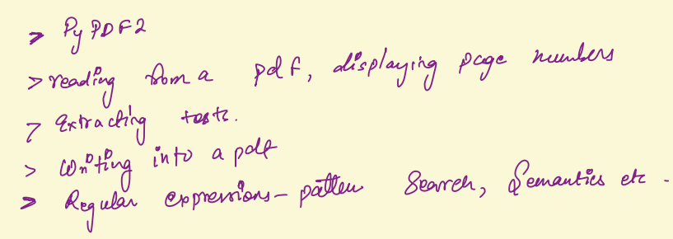

PDF Handling in Python
pdf_basics
PyPDF2 Library
to read in data from a pdf file.
works only for pdfs exported through editor like word, doesn’t work for scanned images
pip install PyPDF2
import PyPDF2
Reading from a pdf
f=open(‘filepath.pdf','rb') #reads in a binary format
pdf_reader=PyPDF2.PdfReader(f) #creates an object
len(pdf_reader.pages) #displays the number of pages
page_one=pdf_reader.pages[0] #gets the first page
page_one.extract_text() #extracts the text
Writing in a pdf
pdf_writer=PyPDF2.PdfWriter()
pdf_writer.add_page(page_one)
pdf_output=open('mynewpdf.pdf','wb’) #creates a new file if doesn’t exist
pdf_writer.write(pdf_output)
pdf_output.close()
# cannot directly write strings

Slide 5

find the pattern ###-###-####
Regular expressions allow for pattern searching in our text document.
regular expression for above is '\d\d\d-\d\d\d-\d\d\d\d' , \d is the placeholder for an integer and the syntax is '\d{3}-\d{3}-\d{4}'
Regular Expressions
pdf_basics
functions in re
import re
re.search(pattern,text) #searches first instance pattern in the text
re.findall(pattern,text) #searches all instances of pattern in the text
re.findall(r".at","the cat in the hat sat")
re.finditer("phone",text)
pattern=r'\d{3}-\d{3}-\d{4}’
f= re.search(pattern,text)
f.group()

Slide 6



Natural Language Processing
NLP: area of AI concerned with training computers to process and analyze large amounts of natural/human language data.
Spacy
Open source NLP library.
For many NLP tasks Spacy has only one implemented method, the most efficient algorithm currently available.
Released:2015
NLTK
provides many functionalities but includes less efficient implementations.
Released 2011
Spacy is much faster and more efficient at the cost of user not being able to choose algorithmic implementations.
Spacy does not include pre-created models for some applications such as the sentiment analysis, which is easier to perform with NLTK

Slide 7
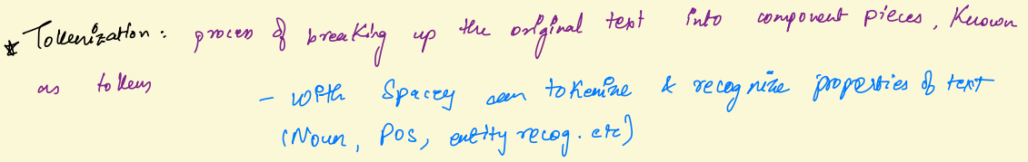
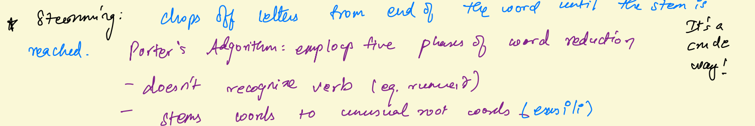
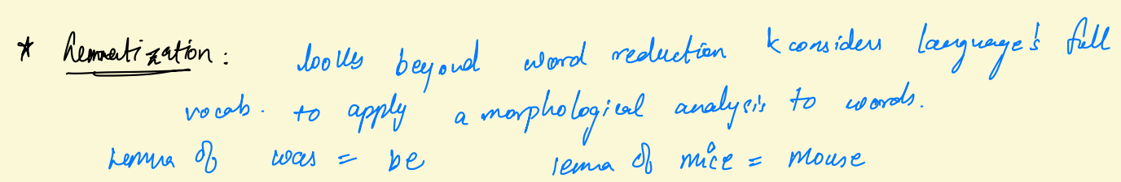


Considers the context in which the word is used by looking at the neighbouring words

Slide 8
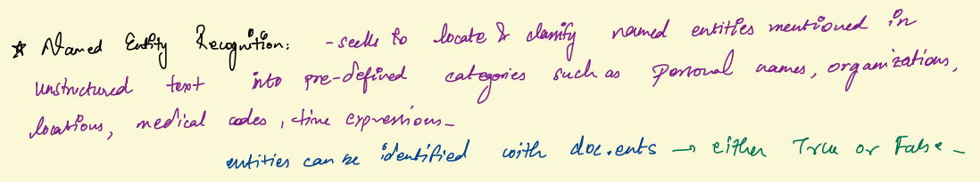
SPACY BASICS
nlp = spacy.load('en_core_web_sm’)
doc=nlp(u’She is running’)
for token in doc:
print(f'{token.text:{10}} {token.pos_:{8}} {token.tag_:{6}} {spacy.explain(token.tag_)}’)
Named Entity Recognition
for ent in doc.ents:
print(ent.text+' - '+ent.label_+' - '+str(spacy.explain(ent.label_)))
for sent in doc.sents:
print(sent)
SPACY BASICS
Lemmatization
doc = nlp(u“Some text")
for token in doc:
print(token.text, token.pos_, token.lemma, token.lemma_)
Stop Words
print(nlp.Defaults.stop_words)
nlp.vocab['myself'].is_stop
nlp.Defaults.stop_words.add('btw’)
nlp.Defaults.stop_words.remove('beyond')
spacy
lemma
pos
ner
stop_words

Slide 9
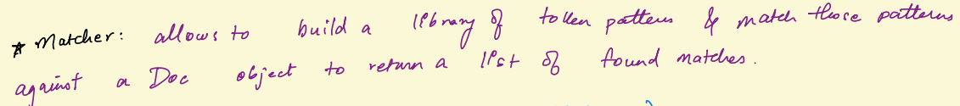
SPACY BASICS
from spacy.matcher import Matcher
matcher = Matcher(nlp.vocab)
pattern1 = [{'LOWER': 'solarpower’}]
pattern2 = [{'LOWER': 'solar'}, {'LOWER': 'power’}]
pattern3 = [{'LOWER': 'solar'}, {'IS_PUNCT': True},
{'LOWER': 'power’}]
matcher.add('SolarPower', None, pattern1, pattern2,pattern3)
found_matches = matcher(doc)
print(found_matches)
matcher.remove('SolarPower')
matcher

Slide 10

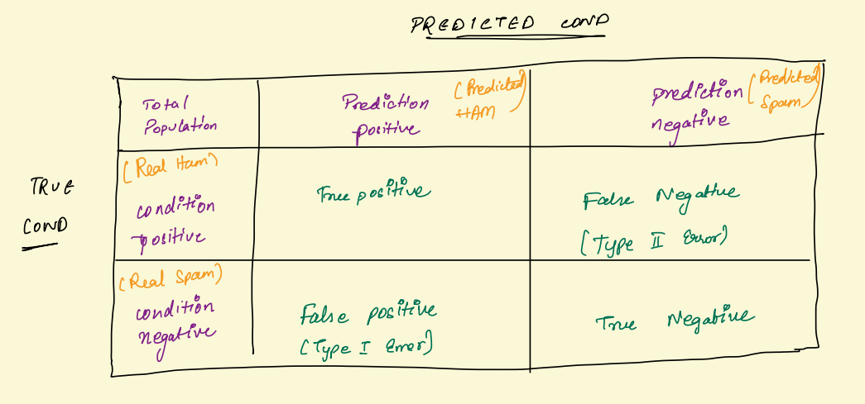
Confusion
Matrix

Slide 11
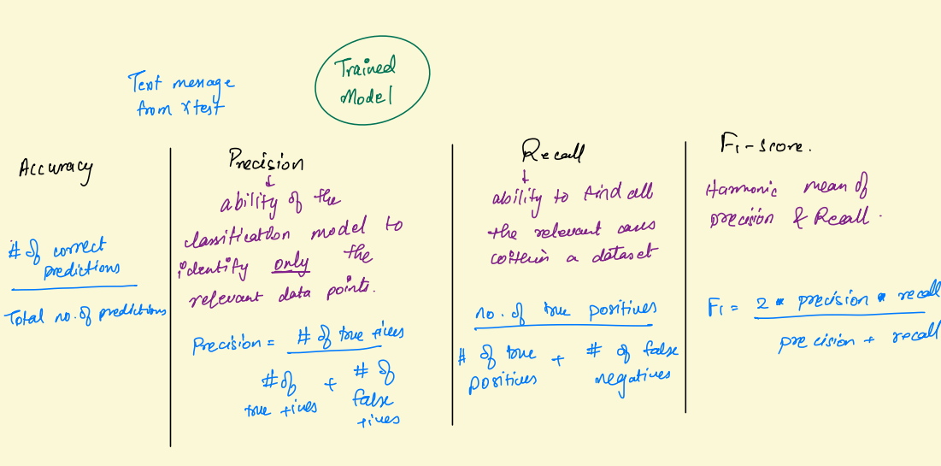

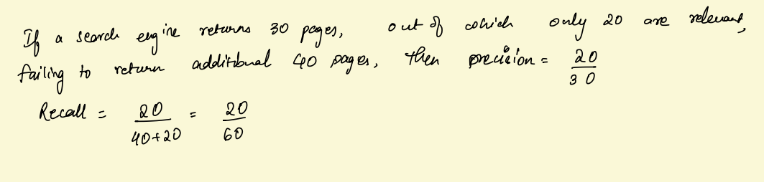
Classification Metrics

Slide 12

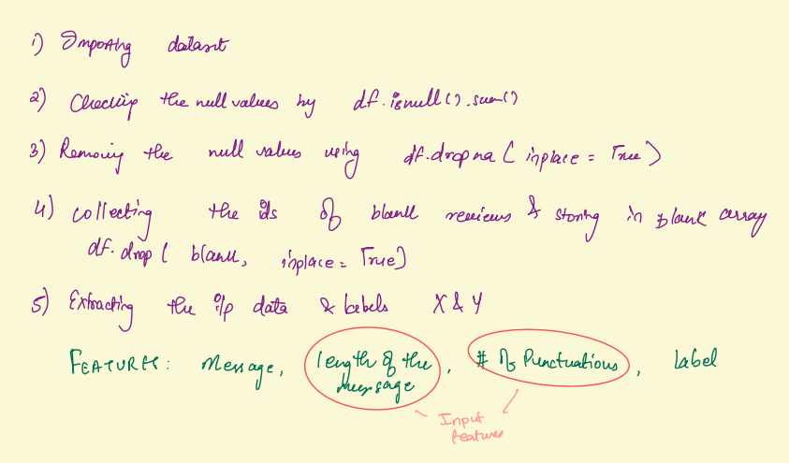
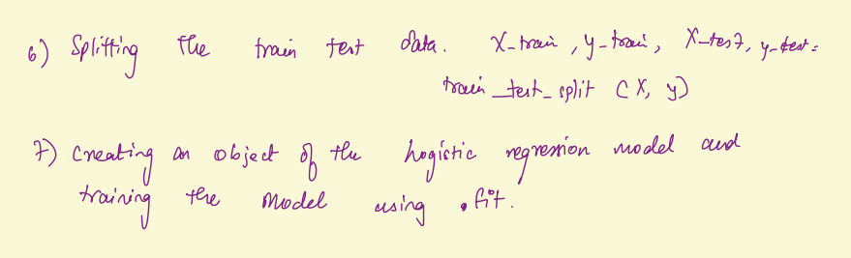

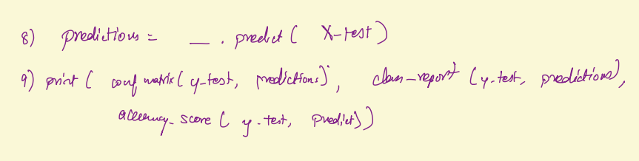
Spam Classifier using Binary Classification
Text Classification
Text classification is a supervised ML technique that can be used to organize, structure, and categorize pretty much any kind of text
spam_classifier

Slide 13
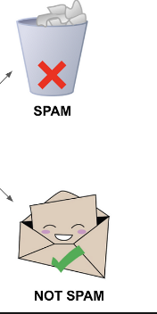
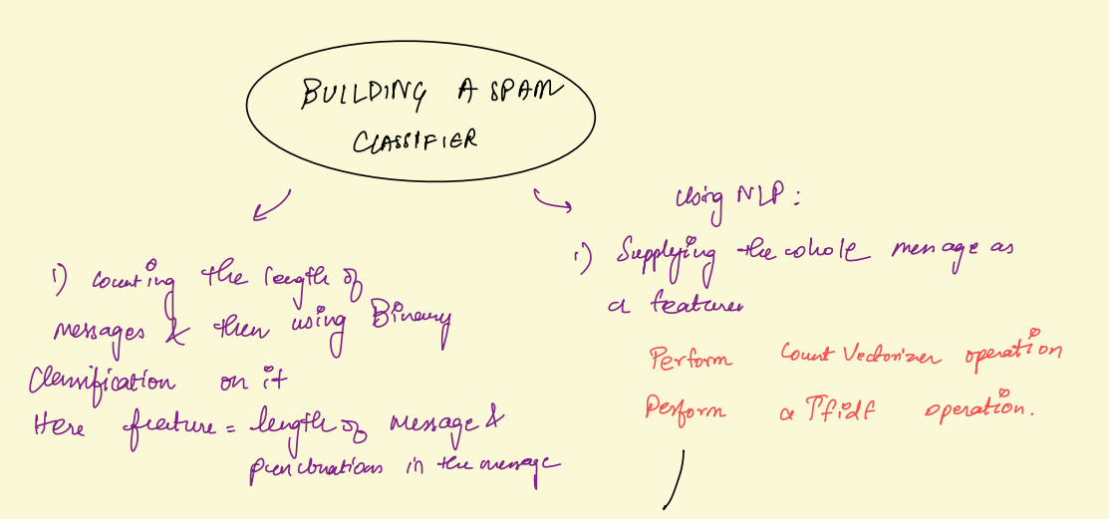

But How?

Slide 14
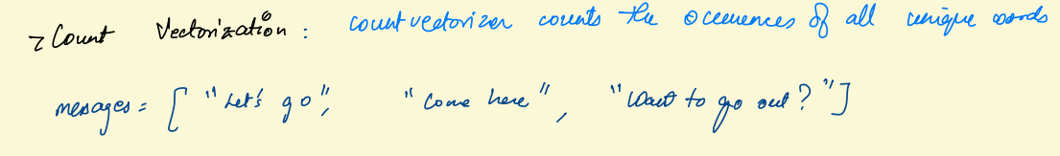
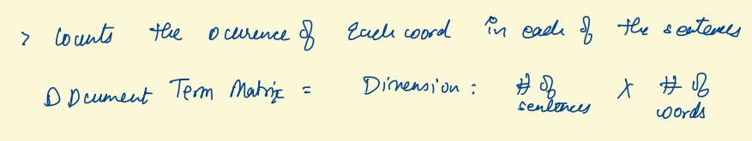
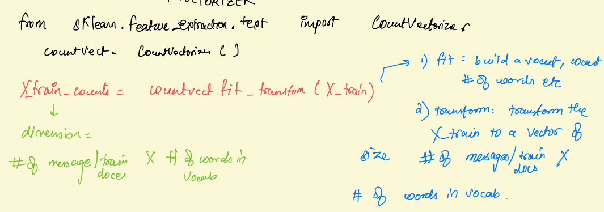
1) Count Vectorization
While counting words is helpful, longer documents will have higher average count values than shorter documents, even though they might talk about the same topics.
count_vectorization

Slide 15

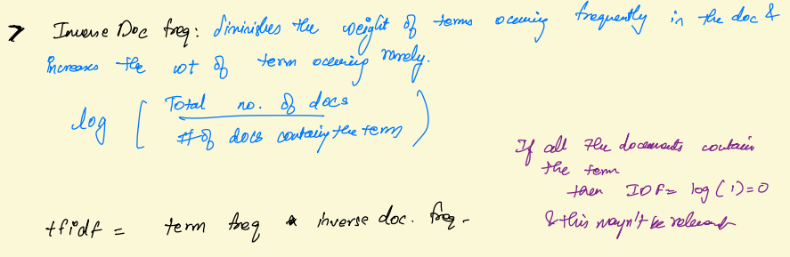
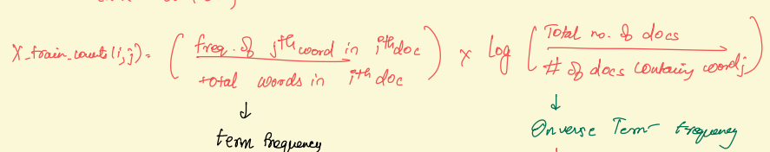
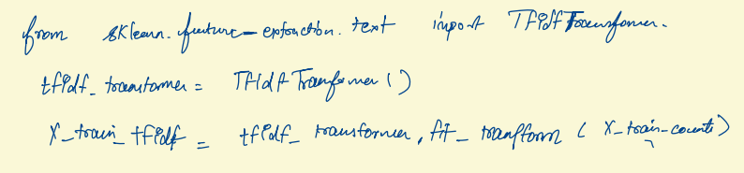
downscale weights for words that occur in
many documents in the corpus and are therefore less informative than those that occur only in a smaller portion of the corpus.
2)TF-IDF Vectorization
Term Frequency(Tf)
of a word in a document is the number of occurrences of that word in the document by the total number of words in the document.
tfidf_vectorizationn

Slide 16

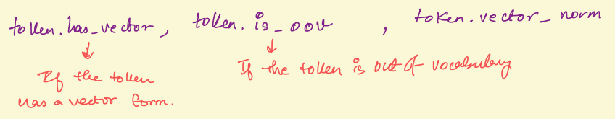

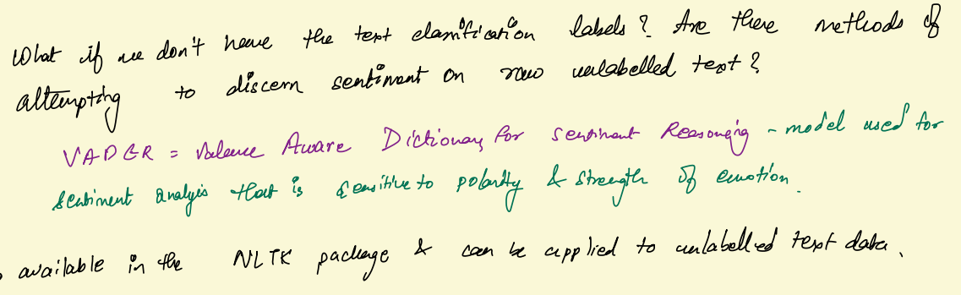
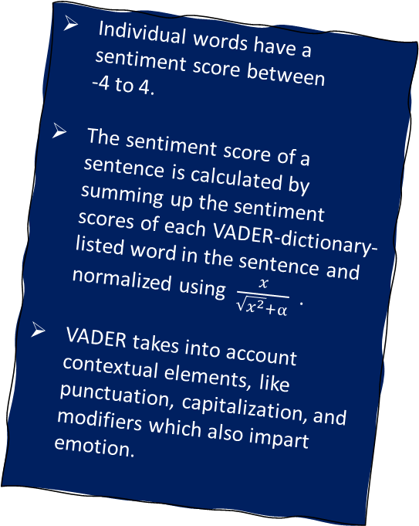
Sentiment Analysis
aims to determine the overall contextual polarity or emotional reaction to a document.
Try to extract intended meanings from complex phrases through ML algorithms like word2vec.
Sentiment Analysis using Spacy and VADER
Word2vec
creates numerical arrays, or word embeddings for every word in a large corpus.
Each word is assigned its own vector in such a way that words that frequently appear together in the same context are given vectors that are close together.
sent_spacy
Individual words have a sentiment score between
-4 to 4.
The sentiment score of a sentence is calculated by summing up the sentiment scores of each VADER-dictionary-listed word in the sentence and normalized using $\frac{x}{\sqrt{x^{2}}+α}$ .
VADER takes into account contextual elements, like punctuation, capitalization, and modifiers which also impart emotion.

Slide 17
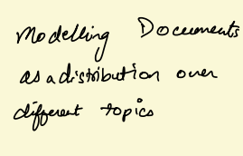
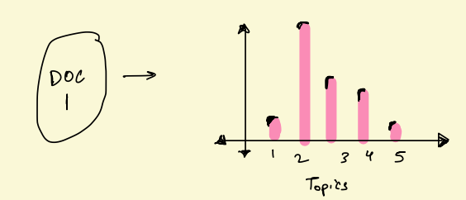
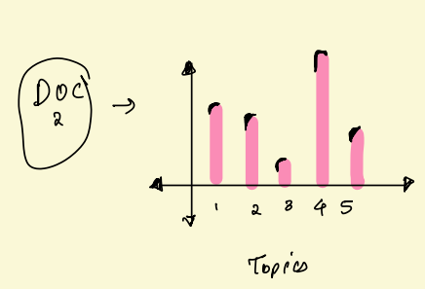
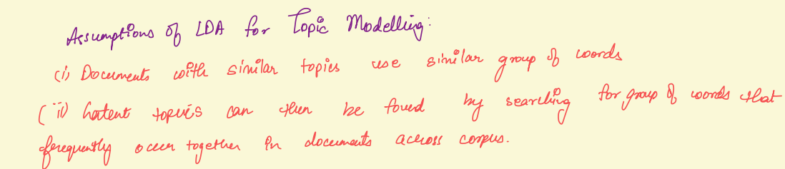
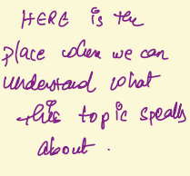
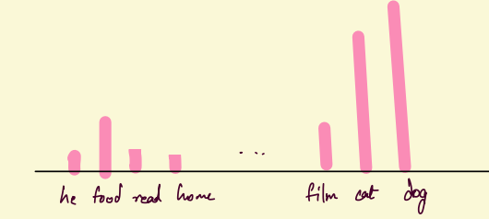
TOPIC MODELLING
with LDA
Topic Modelling allows to analyse large volumes of text by clustering documents into topics.
Text is unlabelled so Can’t apply any of the previous supervised ML techniques.
Latent Dirichlet Allocating(LDA) for TM
Idea:
i)Documents are probability distributions over Latent topics
ii)Topic themselves are probability distribution over words.

Slide 18
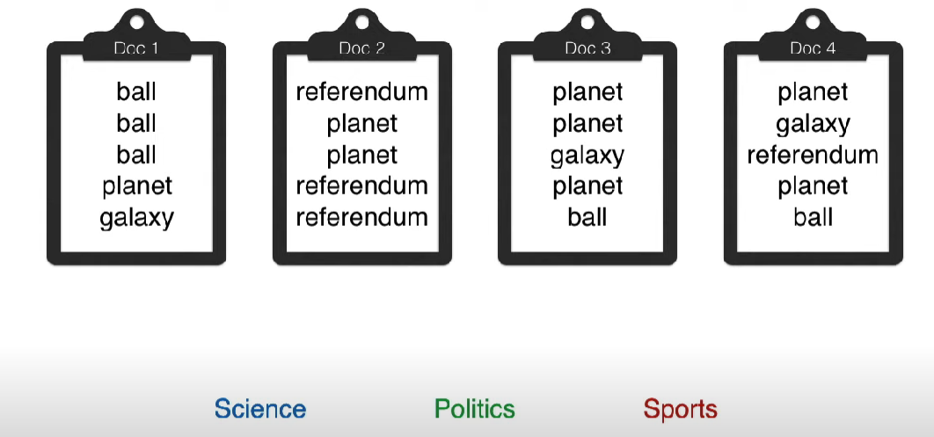
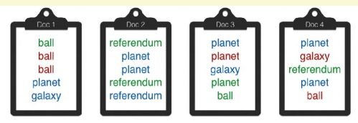
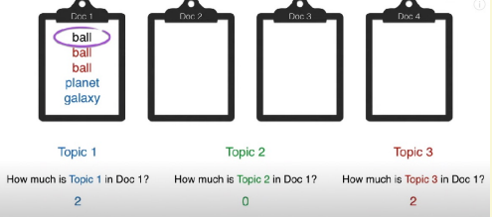
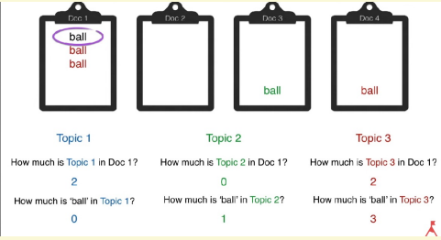
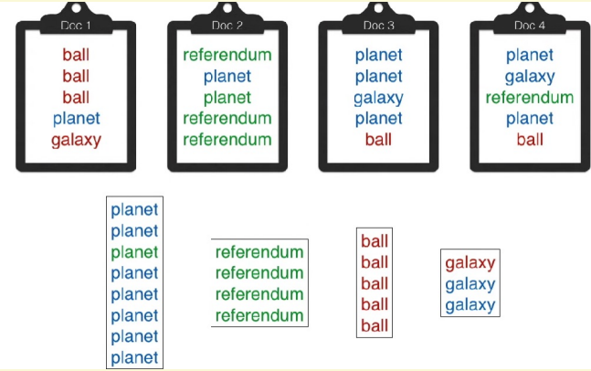
Classify four documents into topics based on the words in each document.
Choose the number of topics K, K=3 : Red, Blue, Green
Randomly assign each topic to each word.
Pick a word w assuming the assignments of topics to rest of the words is correct and find:
(i) P(topic j |doc i )
(ii)P(w|topic j) #consider instances of w in all docs
Assign the topic j having the greatest value of P(w|topic j) * P(topic j |doc i ) to the word w.
Continue the process for each word in all the documents until the assignments no longer change.
Group the words in each of the topics and identify the topic. Assign the topics to each of the documents.

Slide 19
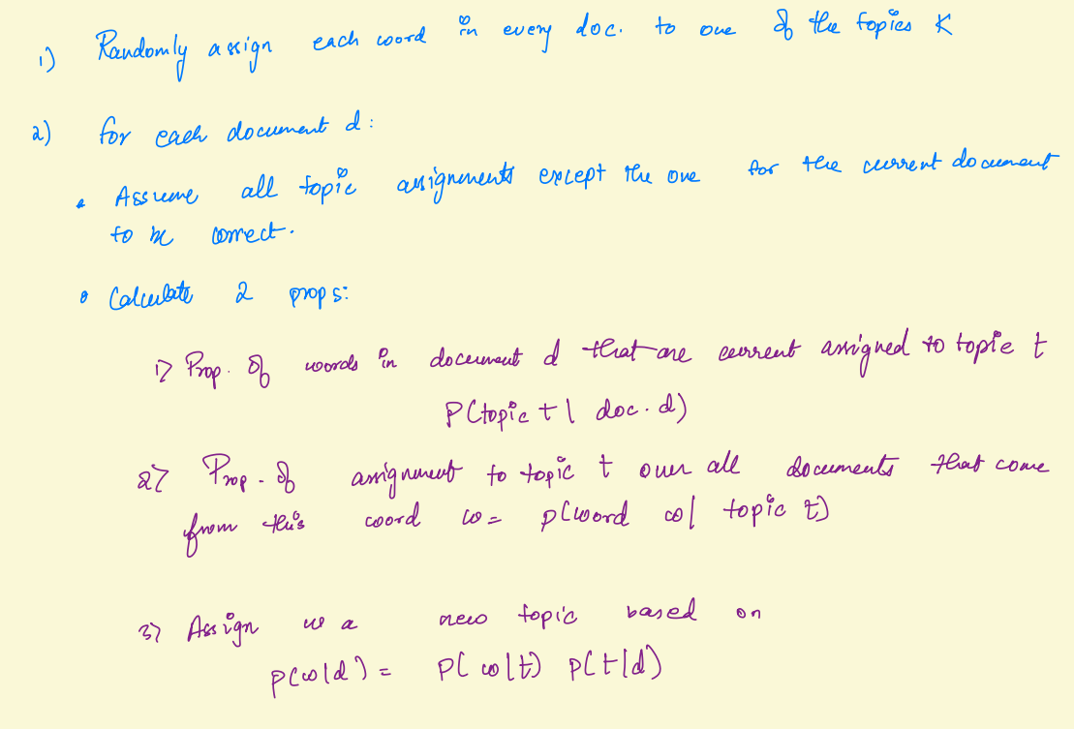
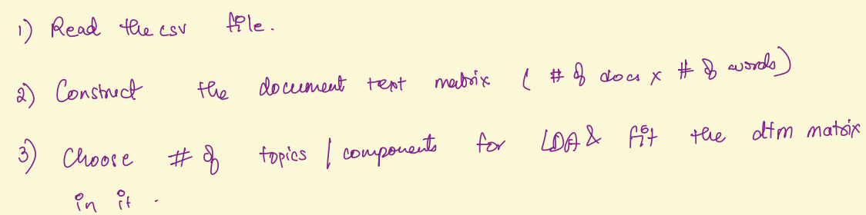
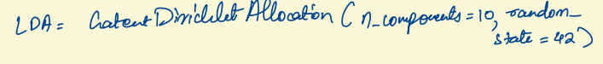
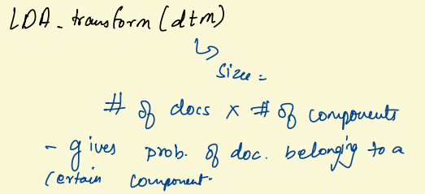
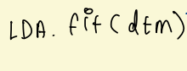
LDA Algorithm
LDA_article

Slide 20
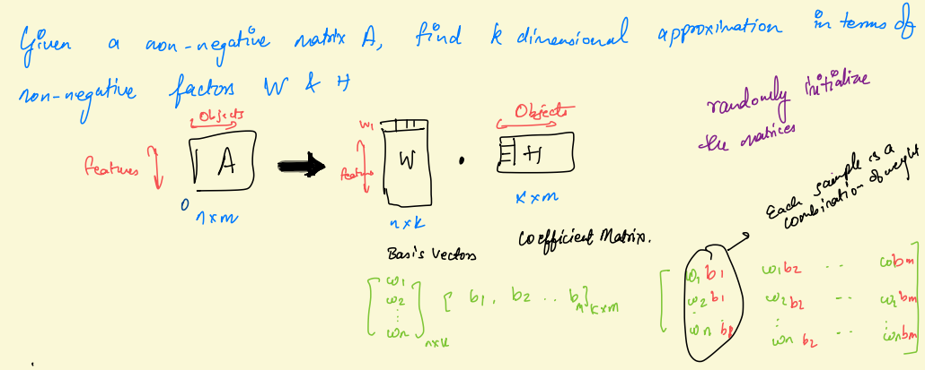
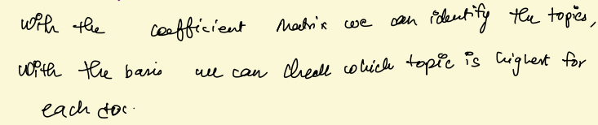
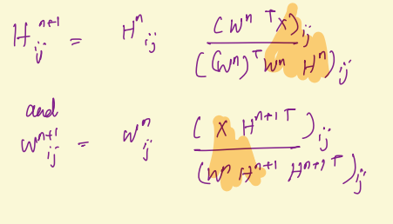
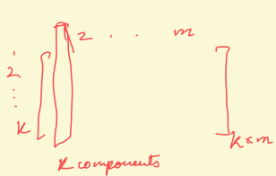
TM with
Non Negative
Matrix Transformation
NMF
Unsupervised algorithm to identify topics in a corpus of documents through dimensionality reduction.
Can use in conjunction with TF-IDF to model topics across documents.
Faster compared to LDA
Updates
for NMF

Slide 21
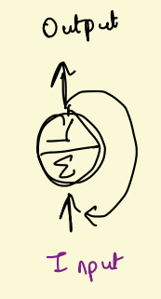
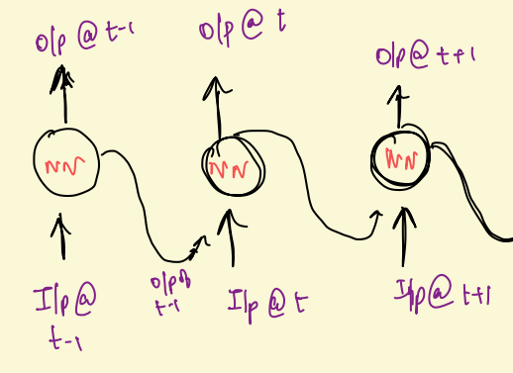
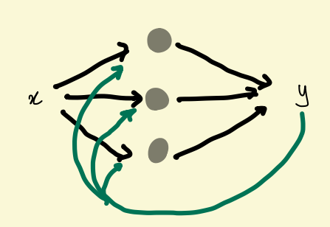
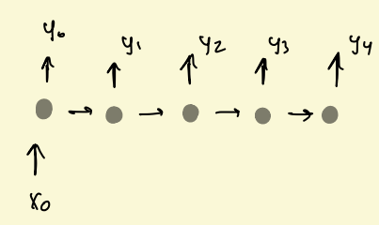
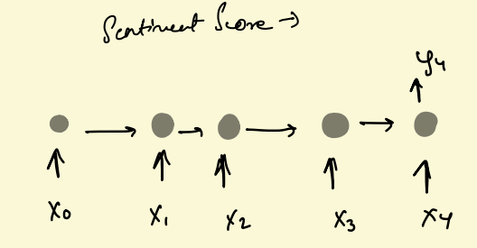

Recurrent Neural Networks
RNN are NN designed to specifically work with sequence data like sentences, music, audio etc
Neurons receive both inputs from previous time steps and the current time step.
Cells that are a function of inputs from the previous time step are called memory cells.
Vector to sequence
Sequence to vector
sequence to sequence

Slide 22





RNN with a single neuron

Slide 23






LSTM

Slide 24






Train a LSTM NN to predict the 26 th word given the first 25 words of the sequence
lstm
Model Architecture

Slide 25










Slide 26



Embedding Layer

Slide 27



End to End Memory Networks
chatbot
CHATBOTS
Implement a chatbot that answers(yes/no) queries based on a story
A chatbot is a computer program that uses NLP to understand customer questions and automate response simulating a human conversation.

Slide 28






Slide 29




Slide 30






Slide 31
THANK YOU

